Slide 1


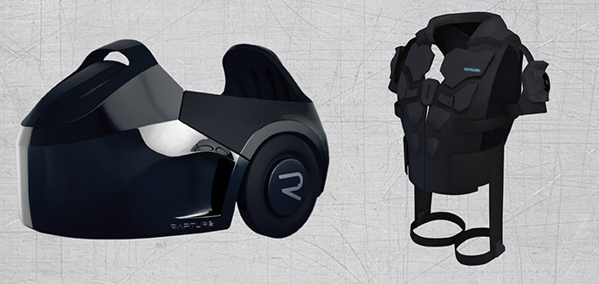
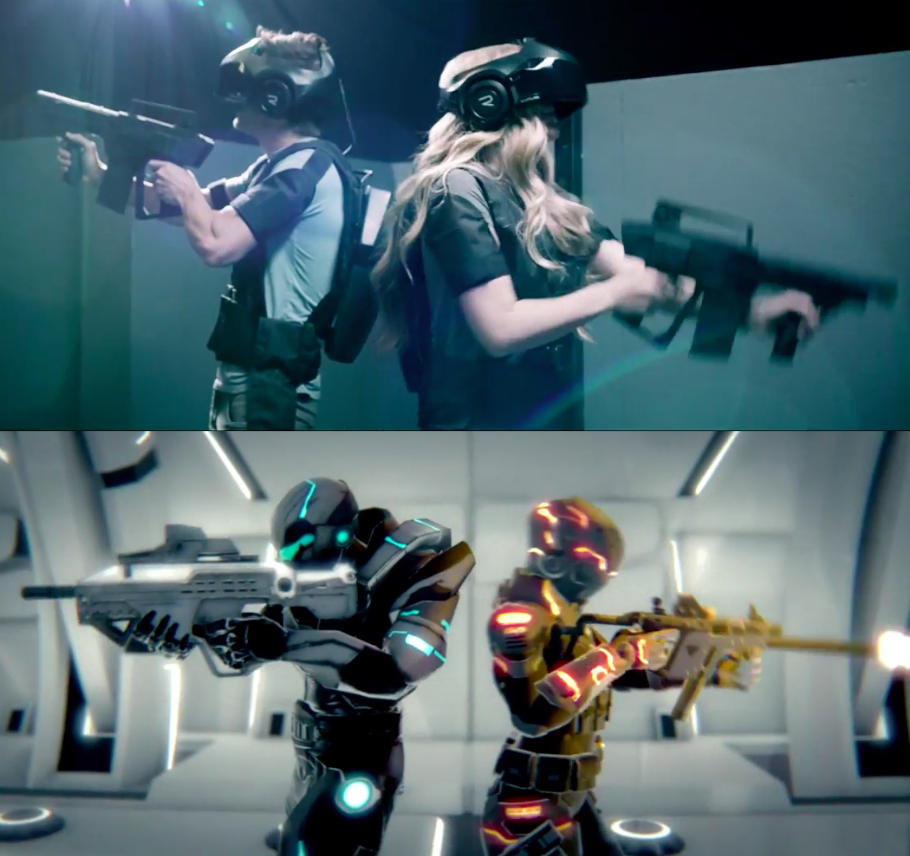

Slide 2

Vision of Infinite Dimensions
Whole body, fully immersive VR experience

Slide 3
Why is it a good use of VR? Why is it unique? What’s cool about it?
The void built in LAN environment avoiding latency issues and provide physical feedback.
It is unique cause it has hyperreality experience hinge on a VR environment.
The void can use a combination of virtual reality hardware with motion tracking.
The VOID is starting to realize the vision of exploring infinite virtual worlds at 1:1 scale

Slide 4
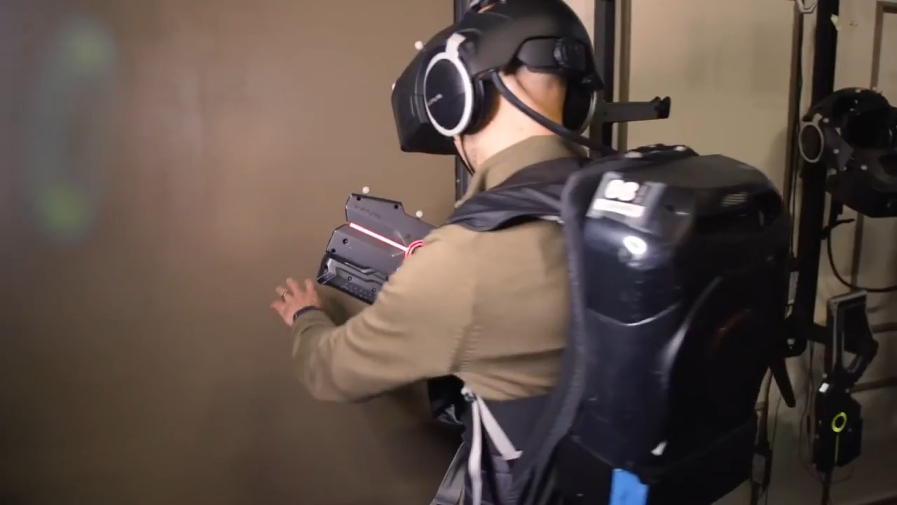

Slide 5
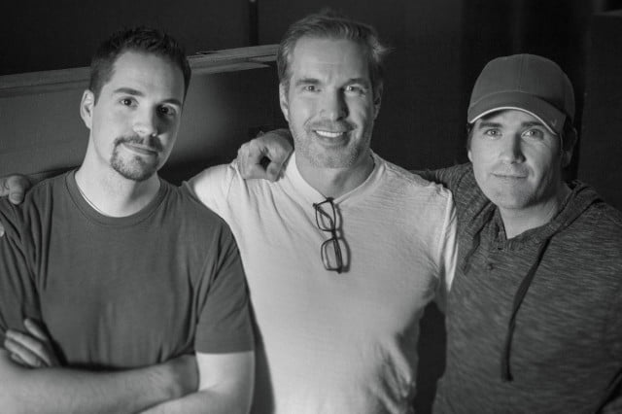
History of The Void
The Void was co-founded by Ken Bretschneider, Curtis Hickman and James M.Jensen. Bretschneider focused on developing the void after he decided to stop Evermore project.

Slide 6
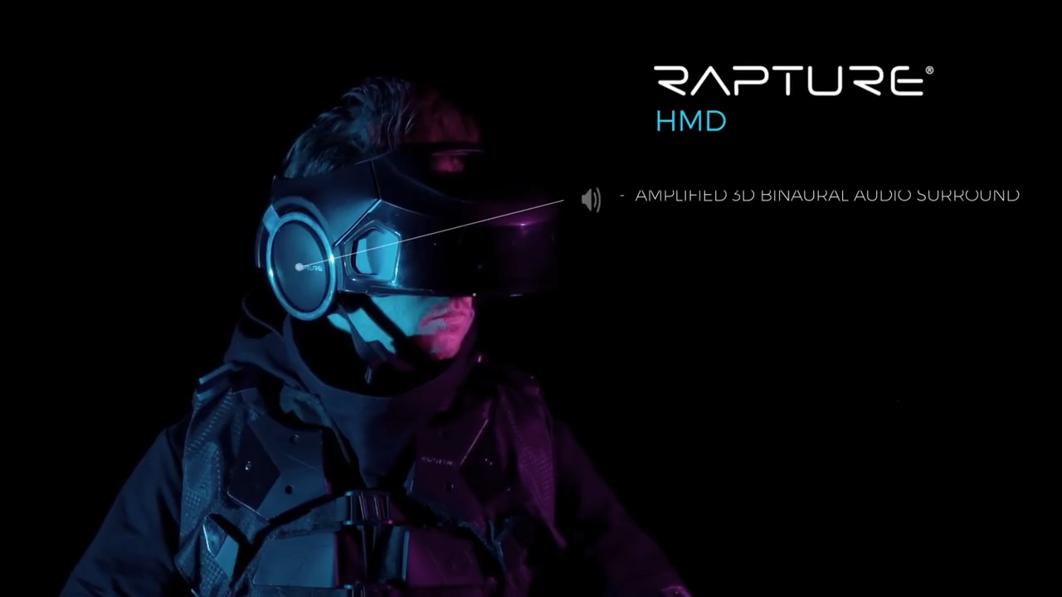
Technology

Slide 7
The void simulated the interior of a spaceship utilizing an Oculus Rift developer kit which used for position tracking.
The vest system utilized an Oculus Rift Devlopment Kit2, Beats by Dr. Dre headphones and a Leap Motion unit for hand tracking.
How does it work?

Slide 8
Where is it used? What are best suited applications?
The void is designed to allow the users to freely walk through and explore a virtual world.
For playing, education-oriented experience like police tranning and nature exploration.

Slide 9
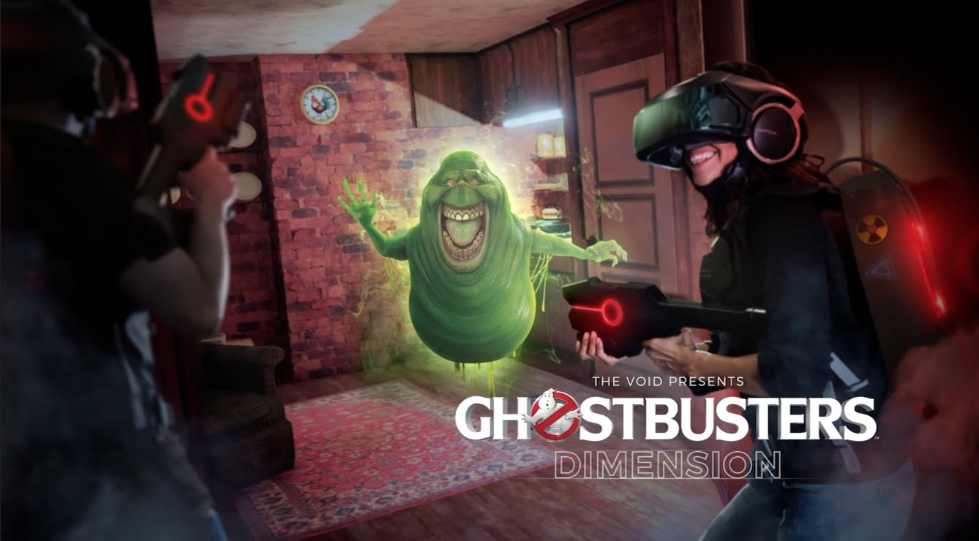
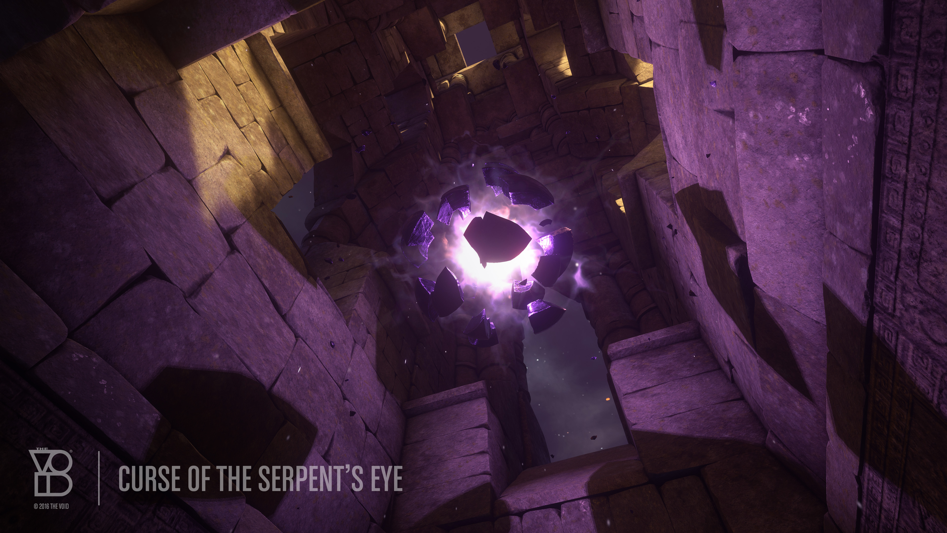

weaknesses
Ghostbusters:Dimension
The Curse of the Serpent’s Eye
star wars secrets of the empire

Slide 10
strengths
30-minute experience
price:$29.95

Slide 11
* Can this lead to varying degrees of simulator sickness including nausea, fatigue, headache, eyestrain, vertigo, and dizziness? * What is your rating on the scale from 0 to 10?
0: Normal (no motion sickness at all)
5: Average (lead to dizziness) -> can not use it for more than a few minutes
10: Max (can be dangerous)
0

Slide 12
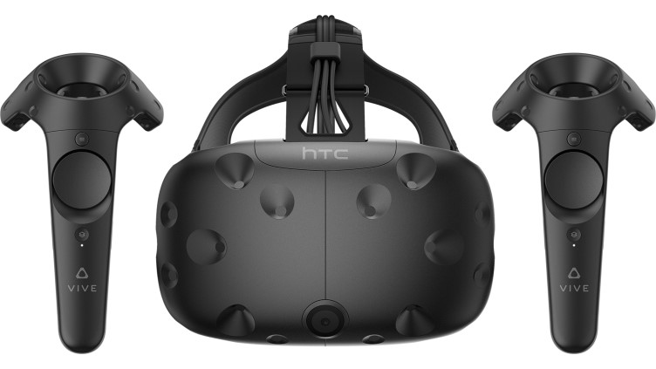
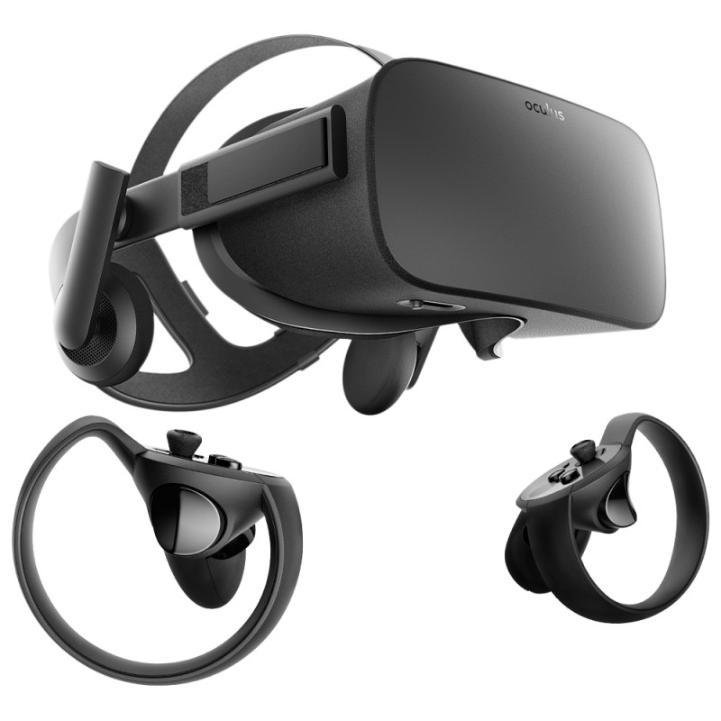
What are the similar/related applications?
HTC VIVE
Oculus Rift

Slide 13
Conclusion

Slide 14
Reference
https://www.technologyreview.com/s/544096/inside-the-first-vr-theme-park/
https://www.wired.com/2017/02/the-void-vr-game/
https://www.digitaltrends.com/computing/how-the-void-plans-to-put-reality-back-in-virtual-reality/

